Slide 1
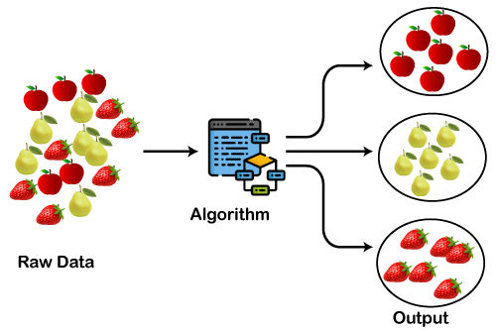
Clustering Algorithms
Tingting Chen

Slide 2
Outlines
Research goals
What is clustering?
Common clustering algorithms
Application
Challenges
Conclusion
References
Q&A

Slide 3
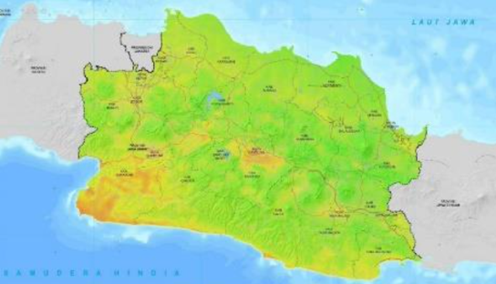
Research goals
Based on the DBSCAN algorithm, we classify earthquake-prone areas and create a seismic hazard index map by clustering density. This aims to provide effective information to the public regarding regions susceptible to earthquakes, enhancing awareness of seismic risks.

Slide 4
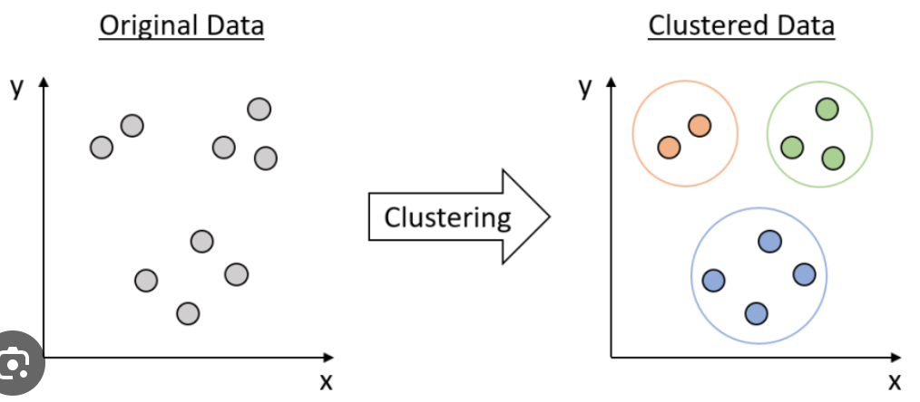
What is Clustering?
Clustering is an unsupervised machine learning technique for grouping similar data points into clusters, where data points in the same cluster share more characteristics than those in other clusters.
The goal of clustering is to identify underlying patterns or groupings in data without prior knowledge of labels or categories.

Slide 5
Common Clustering Algorithms
k-means: Partitions the data into k clusters based on minimizing within-cluster variance.
Hierarchical Clustering: Builds a tree (dendrogram) of clusters, either merging or splitting them at each step.
DBSCAN (Density-Based Spatial Clustering of Applications with Noise): Groups points based on density, identifying clusters of high-density regions and outliers.
Gaussian Mixture Models (GMM): Assumes that the data is generated from a mixture of several Gaussian distributions and assigns probabilities for each data point belonging to a cluster.

Slide 6
Other Clustering Algorithms
Clustering
Partition-Based
Hierarchical-Base
Density-Based
Grid-Based
Model-Base
K-means
AGNES
DBSCAN
STING
GMM
K-medoids
DIANA
OPTICS
CLIQUE
HMM
DENCLUE

Slide 7

Applications of Clustering
Customer segmentation in marketing.
Document or text clustering in natural language processing.
Image segmentation in computer vision.
Anomaly detection in various domains.

Slide 8
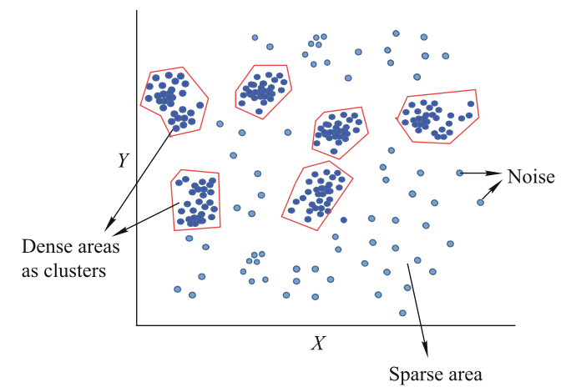
Density-based Algorithm
Density-Based Spatial Clustering of Application with Noise（DBSCAN）
Principle: find the neighborhoods of data points exceeds certain density threshold
DBSCAN defines a cluster as a dense region, where:
Core Point: A point that has at least MinPts points within its ε-neighborhood.
Border Point: A point that is within the ε-neighborhood of a core point but is not a core point itself.
Noise Point: A point that is neither a core point nor a border point.

Slide 9

Key Characteristics:
Eps: Epsilon(ε-neighborhood), the neighborhood range of the points.
MinPts : The minimum number of points that must be present in the neighborhood to form a cluster, including core point.

Slide 10
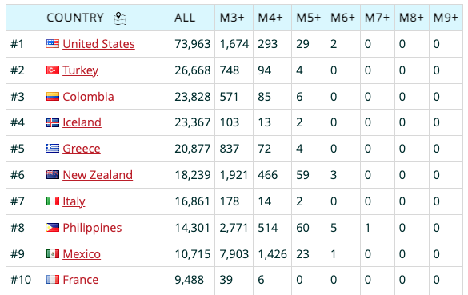
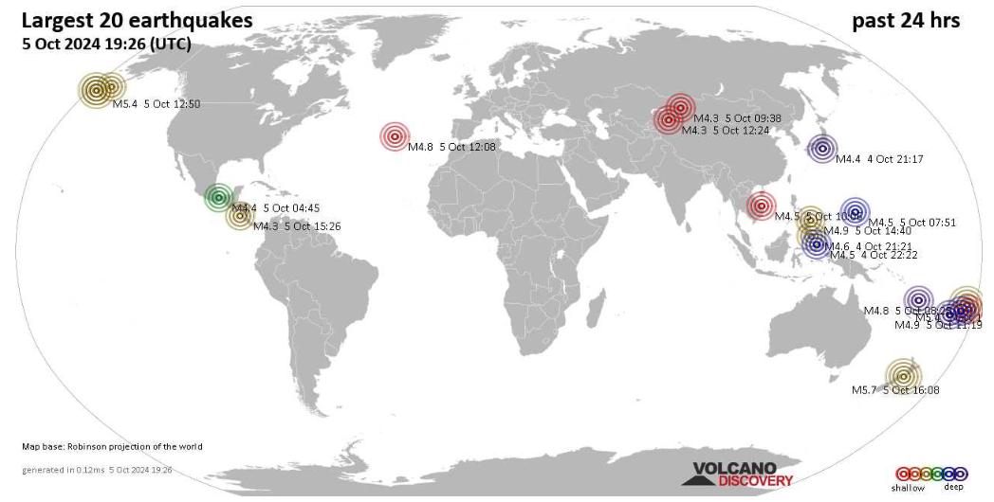
Application-Earthquake spread location
A list of countries with most earthquakes in 2024
maps of the 20 largest earthquakes during the past 24 hours
https://www.volcanodiscovery.com/largest-recent/earthquakes.html

Slide 11
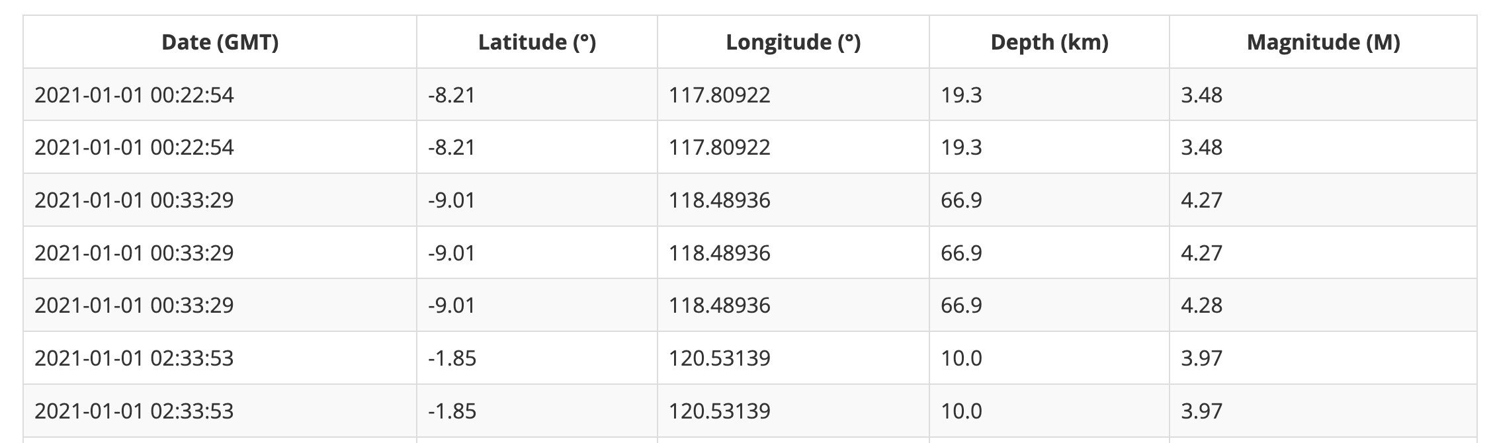
Datasets
Timestamp
Latitude
Longitude
Depth
magnitude
Data Source: BMKG online database providing data and information about earthquakes
https://dataonline.bmkg.go.id/data_gempa_bumi
Notes:
Indonesian Meteorology, Climatology and Geophysics Agency (BMKG) online database providing data and information about earthquakes
laporan_data_gempa_rawdata.xlsx
Variables： latitude and longitude
Depth and magnitude variables are used to see the characteristics of each set of earthquakes

Slide 12
Challenges & Solutions
Challenges
Complicated spatial distribution
Parameter sensitive
Data Noise and Outliers
Solutions
Using DBSCAN Algorithm
Optimization of MinPts parameters
Identify density reachable

Slide 13

Advantages of DBSCAN
Noise Robustness: Easily deal with noise, not affected by outliers.
Cluster-Free Initialization: Doesn’t require prior specification of clusters.
Flexibility in Cluster Shapes: It has no strict shapes; it can correctly accommodate many data points.

Slide 14
Disadvantages of DBSCAN
Sensitivity to Hyper-parameters: sensitive to the clustering hyper-parameters – the eps and the min_points.
Difficulty with Varying Densities: cannot work with datasets of varying densities.
Sparse Data Limitations: fails if the data is too sparse.
Impact of Sampling on Density Measures: the density measures (Reachability and Connectivity) can be affected by sampling.

Slide 15
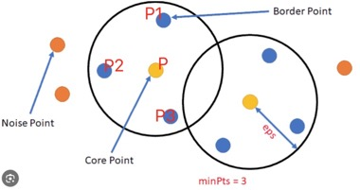
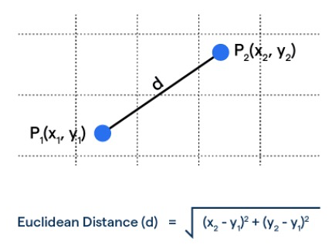
Implementation
Find Eps-neighborhood of a point
NEps(P) = {q ∈ D | dist(p, p1) ≤ Eps}
Dist: Euclidean Distance
Notes:
Eps-neighborhood of a point defines the neighborhood around a data point.
NEps(P): represents the Eps neighborhood of point P, which includes all points whose distance to point P does not exceed Eps.
q ∈ D : represents the point q in the dataset D
dist(p, q): represents the distance between P and P1
Eps: The preset distance parameter represents the maximum neighborhood range between calculation points.

Slide 16
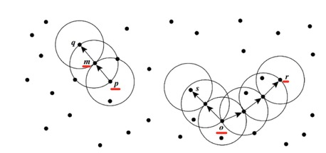
Implementation
Find which points should belong to the same cluster & Identify noise data
directly density-reachable
m->q, p->m q and m: core point
(indirectly) density-reachable
o->r, o->s
density-connected
s-r
minPts=3
Notes:
Points 𝑚, 𝑝, 𝑜, 𝑟 are core objects because each one is in a Eps-neighborhood that contains at least three points. Object 𝑞 directly density-reachable from m. Object m is directly density-reachable from 𝑝 and vice versa. Object 𝑞 is (indirectly) density-reachable of 𝑝 because 𝑞 is directly density-reachable of m and m is directly density-reachable of 𝑝. However, 𝑝 is not density-reachable from 𝑞 because 𝑞 is not a core object. Similarly, r and 𝑠 are density-reachable of 𝑜 and 𝑜 is density-reachable of 𝑟. Therefore, 𝑜, 𝑟, and 𝑠 are all density-connected.
directly density-reachable and density-reachable is a directed and asymmetric relationship
density-connected is an undirected and symmetric relationship

Slide 17
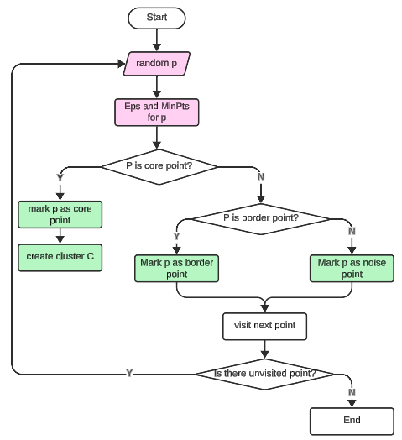
Implementation
Input:
Earthquake data set D
MinPts (minimum points required for a dense region)
Eps (maximum distance between two samples)
Output: Clusters of earthquake locations, noise points.
1. Start
2. Select initial point p randomly from the dataset D
3. Determine Eps and MinPts for point p
4. If p is a core point:
5. Mark p as a core point
6. Form a new cluster with p
7. Else If p is a border point:
8. Mark p as a border point
9. Else:
10. Mark p as noise
11. Visit the next point in the database
12. If there are unvisited points:
13. Go back to step 2 (Select initial point p randomly)
14. Else:
15. End

Slide 18
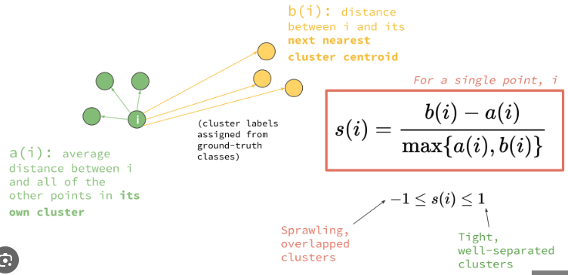
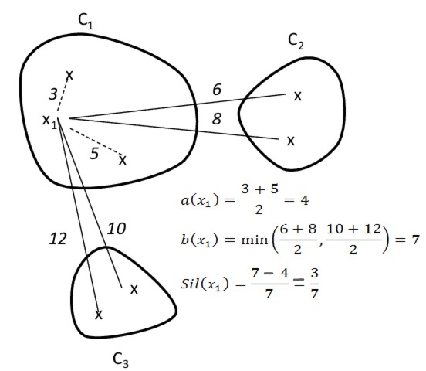
Evaluation
Silhouette Coefficient: the maximum value of the average silhouette width for the entire data set.
Notes:
a(i) The average distance to all other points in the same cluster
b(i) The average distance of all points in the nearest different clusters
advantage:
-1<score<1
-1: incorrect clustering
1: highly dense clustering
Disadvantage :
the coefficient is generally higher for convex clusters than other concepts of clusters.

Slide 19
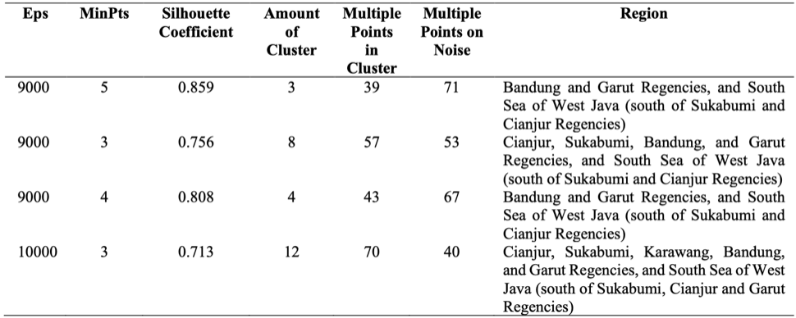
Optimization of Parameters
best clustering result:
highest silhouette coefficient
more clusters is selected
Notes:
Adjust different parameters and calculate the corresponding silhouette coefficient, and determine the best parameters based on the calculation results.
The parameter combination with the highest silhouette coefficient and more clusters is selected as the best clustering result.
1. highest silhouette coefficient: the silhouette coefficient is close to 1, which means the density of clustering is higher.
2. more clusters is selected: the larger the number of clusters that are formed, the more areas that are prone to earthquakes are detected
multiple points in cluster less than multiple points on noise means:
1.the number of points in the cluster is small, indicating that the similarity between these points is insufficient and it is difficult to form effective clusters(The 2.clusters are not dense enough: )
3.Or there are a large number of outliers or noise points in the data, which are not suitable for any cluster.
4.Or the settings of Eps and MinPts may not be appropriate, resulting in the inability to effectively identify clusters(Poor parameter settings: ).

Slide 20
Conclusion
Clustering algorithm is widely used.
DBSCAN is very effective in handling clusters with complex shapes and noise data.
Consideration of Additional Factors in Earthquake spread location application.
Notes:
在地震分布位置这个应用中还应该考虑其他因素导致的问题，例如密度分布不均匀对聚类效果的影响，
还有不仅需要对空间属性进行聚类，还需要其他的属性，如时间、颜色、温度等，如果强行对非空间数据与空间数据进行归一化处理会降低该属性的聚类特性
这些都是需要日后进一步探索的内容

Slide 21
References
IMPLEMENTATION OF THE DBSCAN METHOD FOR CLUSTER MAPPING OF EARTHQUAKE SPREAD LOCATION
Multi-step spatiotemporal clustering algorithms for seismic events
A Density-Based Algorithm for Discovering Clusters in Large Spatial Databases with Noise
An Overview of Clustering Models with an Application to Document Clustering
DBSCAN Clustering Algorithm Based on Density
A Survey of Advancements in DBSCAN Clustering Algorithms for Big Data
A survey of density based clustering algorithms
Choosing DBSCAN Parameters Automatically using Differential Evolution
https://medium.com/@MrBam44/how-to-evaluate-the-performance-of-clustering-algorithms-3ba29cad8c03
https://www.janbasktraining.com/tutorials/evalution-of-clustering/
https://www.volcanodiscovery.com/earthquakes/global/stats.html

Slide 22


